Slide 1
Introduction to the Wellness Center Your confidential one stop shop for your physical & mental health
Notes:
The Wellness Center is located in Dominican 122 (in the basement of Dominican). The easiest way to find the center is by using the lakeside entrance facing Lake Wingra and the Siena Apartments. Most other entrances are only accessible to residents.

Slide 2
Wellness Center Dominican 122
Personal Counseling
Free and confidential individual counseling, group counseling, & urgent care (same-day appointments for mental health emergencies).
To schedule, call 608-663-4148 or email PCSNotifications@edgewood.edu
Health Services
Confidential healthcare on campus. There is a fee for each visit, which is typically less than a co-pay depending on your insurance.
Email healthservices@edgewood.edu to schedule an appointment

Slide 3
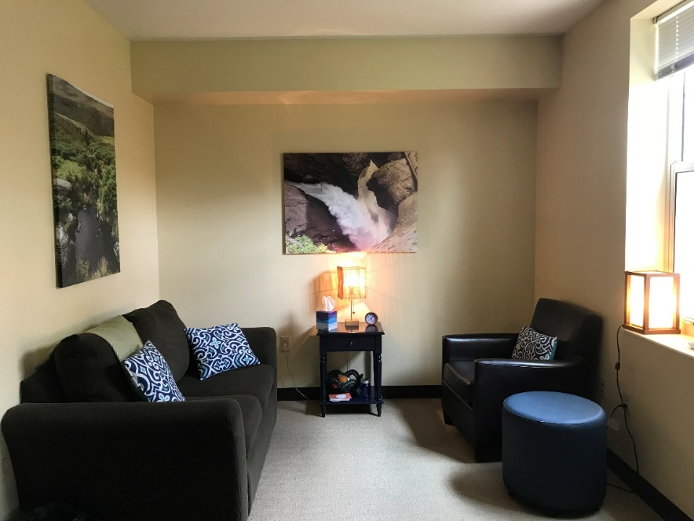
Common Reasons for Seeking Counseling
Stress management
Relationship difficulties
Anxiety
Depression
Grief
Trauma
Substance abuse
Body image concerns or disordered eating

Slide 4
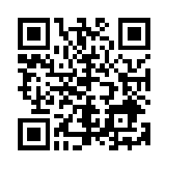
Stress & Depression Questionnaire
Anonymous and confidential screening that allows you to get personalized feedback from a counselor and ask questions
https://edgewood.caresforyou.org/
Notes:
Students generally receive a response from a counselor within 24 hours, unless it’s over a weekend or holiday period.

Slide 5
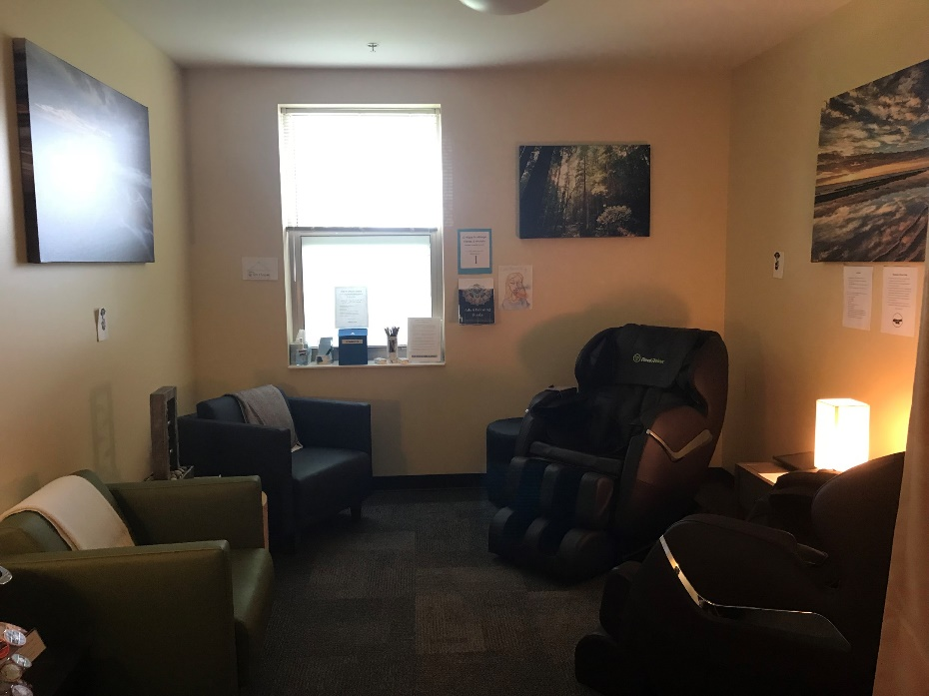
Relaxation Room
Notes:
The relaxation room features two full body massage chairs, a Keurig with coffee, tea, hot chocolate, & cider, brochures about health and wellness, and a low sensory environment conducive to de-stressing.

Slide 6
Questions? Stop by the Wellness Center in Dominican 122!
Notes:
6

